Slide 1
Computer Graphics
Practical Tutorial
First Programs
Kurtuluş KÜLLÜ
Slides based on the slides by Prof. Ed Angel

Slide 2
Overview
We will write a WebGL program that will display a triangle inside a browser window
There are two parts for the task
We need to define the web page using HTML
And we will write the Javascript code which will draw the graphics

Slide 3
Canvas
One of the first things to do is to create a canvas in the HTML file
<body>
<canvas id="glcanvas" width="512" height="512"></canvas>
</body>
Canvas is the area on the page that will display the output of our WebGL program

Slide 4
Script
main();
function main() {
const canvas = document.querySelector("#glcanvas");
// Initialize the GL context
const gl = canvas.getContext("webgl");
// Only continue if WebGL is available and working
if (!gl) {
alert("Unable to initialize WebGL. Your browser or machine may not support it.");
return;
}
// Set clear color to black, fully opaque
gl.clearColor(0.0, 0.0, 0.0, 1.0);
// Clear the color buffer with specified clear color
gl.clear(gl.COLOR_BUFFER_BIT);
}

Slide 5
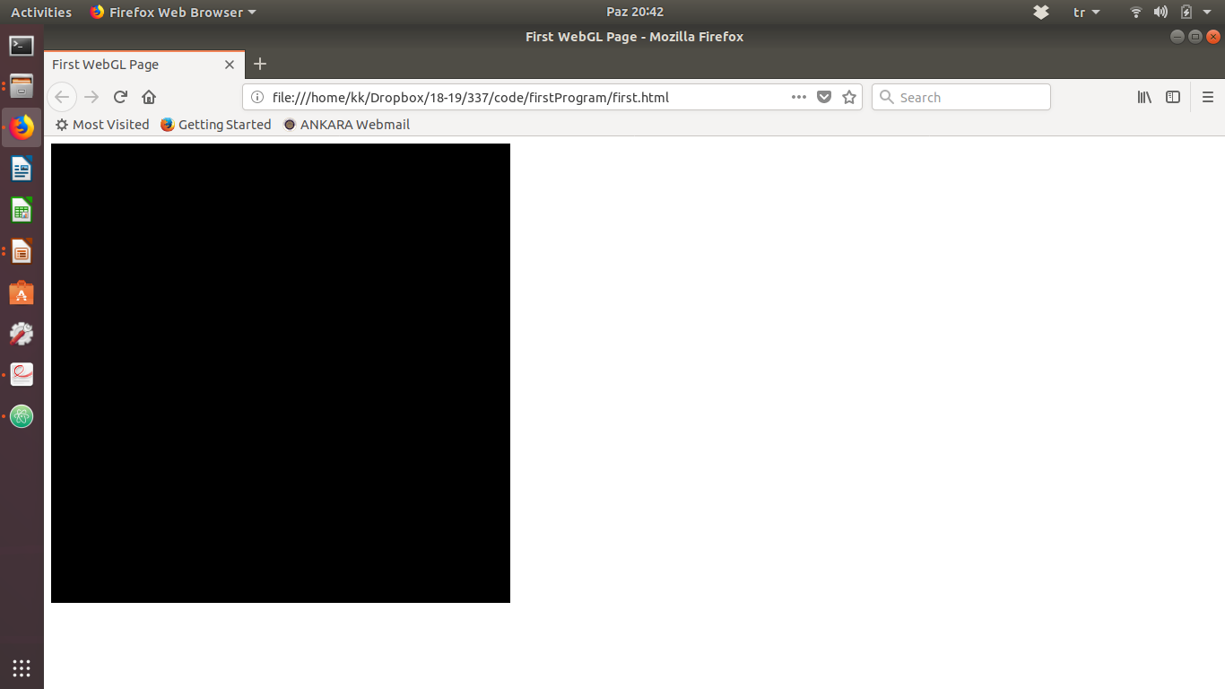
Where are the nice graphics?

Slide 6
It used to be easy
#include <GL/glut.h>
void mydisplay(){
glClear(GL_COLOR_BUFFER_BIT);
glBegin(GL_QUAD;
glVertex2f(-0.5, -0.5);
glVertex2f(-0,5, 0,5);
glVertex2f(0.5, 0.5);
glVertex2f(0.5, -0.5);
glEnd()
}
int main(int argc, char** argv){
glutCreateWindow("simple");
glutDisplayFunc(mydisplay);
glutMainLoop();
}
THIS IS OLD STYLE OPENGL DRAWING
WE ARE NOT DOING THIS ANYMORE

Slide 7
Shader-Based
Unfortunately, our first program will have some confusing extras at the beginning
But,
we don’t need to worry about the details much, and
those extras will remain same for a while

Slide 8
Shaders
Shaders (vertex and fragment) are programs written in GLSL (OpenGL Shading Language), a C-like language with additional types and graphics operations
We write their code, pass them to WebGL to be compiled and linked to create a shader program
These are the codes that will be executed by the GPU during vertex and fragment processing

Slide 9
A Simple Vertex Shader
<script id="vertex-shader" type="x-shader/x-vertex">
attribute vec4 vPosition;
void main(){
gl_Position = vPosition;
}
</script>

Slide 10
A Simple Fragment Shader
<script id="fragment-shader" type="x-shader/x-fragment">
precision mediump float;
void main() {
gl_FragColor = vec4( 1.0, 0.0, 0.0, 1.0 );
}
</script>

Slide 11
Shader Initialization
To use shaders
For each of them
Load its source code, and
Compile
Create a program
Attach shaders to the program
Link program
Note: We do these from inside the Javascript code
Note 2: Don’t forget to handle possible problems such as compilation errors.

Slide 12
Shader Initialization
var vertShdr;
var fragShdr;
var vertElem = document.getElementById( "vertex-shader" );
if ( !vertElem ) {
alert( "Unable to load the vertex shader!" );
return -1;
}
else {
vertShdr = gl.createShader( gl.VERTEX_SHADER );
gl.shaderSource( vertShdr, vertElem.text );
gl.compileShader( vertShdr );
if ( !gl.getShaderParameter(vertShdr, gl.COMPILE_STATUS) ) {
alert( "Vertex shader failed to compile!" );
return -1;
}
}

Slide 13
Shader Initialization
var fragElem = document.getElementById( "fragment-shader" );
if ( !fragElem ) {
alert( "Unable to load fragment shader!" );
return -1;
}
else {
fragShdr = gl.createShader( gl.FRAGMENT_SHADER );
gl.shaderSource( fragShdr, fragElem.text );
gl.compileShader( fragShdr );
if ( !gl.getShaderParameter(fragShdr, gl.COMPILE_STATUS) ) {
alert( "Fragment shader failed to compile!" );
return -1;
}
}

Slide 14
Shader Initialization
var program = gl.createProgram();
gl.attachShader( program, vertShdr );
gl.attachShader( program, fragShdr );
gl.linkProgram( program );
if ( !gl.getProgramParameter(program, gl.LINK_STATUS) ) {
alert( "Shader program failed to link!" );
return -1;
}
gl.useProgram( program );
This may look confusing at the beginning but it is a very standard piece of code
The book authors chose to create a function (initShaders) for this task which is both useful and good for modularity
We will often make similar organizations to make the code easier to understand

Slide 15
A Typical Application
Think of the code in 3 principal parts: initialization, geometry arrangements, and rendering
Initialization involves shader initialization we’ve just seen, forming necessary data structures on the GPU, and setting up callback functions (for interactive applications).

Slide 16
Geometry Arrangements
Let’s draw a triangle
We need 3 vertices
// Three Vertices
var vertices = new Float32Array(
[ -1, -1,
1, -1,
0, 1 ]);

Slide 17
Sending Data to GPU
var bufferId = gl.createBuffer();
gl.bindBuffer( gl.ARRAY_BUFFER, bufferId );
gl.bufferData( gl.ARRAY_BUFFER, vertices, gl.STATIC_DRAW );
We create a vertex buffer object (VBO) on the GPU.
We will put our data for the drawing in this buffer later.
Binding makes this buffer the current buffer to use.

Slide 18
Associating Shader Variables
Enable the vertex attributes that are in the shaders
And describe the form of the data in the vertx array
// Associate out shader variables with our data buffer
var vPosition = gl.getAttribLocation( program, "vPosition" );
gl.vertexAttribPointer( vPosition, 2, gl.FLOAT, false, 0, 0 );
gl.enableVertexAttribArray( vPosition );

Slide 19
Last Addition and
Function Arrangements
The final thing to do is to give the command to the GPU to draw what we specified
gl.drawArrays( gl.TRIANGLES, 0, 3 );
Rearrange with onload function and separate the initialization from drawing (rendering)

